Slide 1
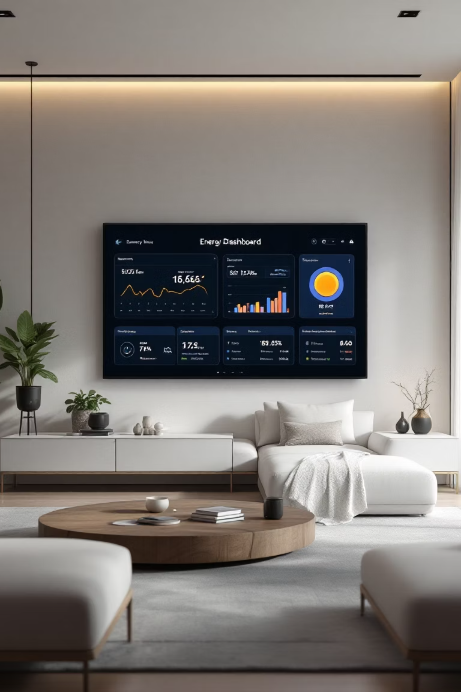
Smart Home Energy Management System
Presented by Team Members :
Fahim Shaik (Team Lead/Project Coordinator)
Kazi Jiya Mukim(Technical Lead)
Bharathi Selvaraj(Tester/Quality Analysts)
Vaishnavi M (Core Developer)
Jiya Jain(Developer Supporting Module
Topic name : Smart Home Energy Management System
Batch : Infosys _ Batch-10 ( Team -3)

Slide 2

Introduction: Redefining Home Energy
What is a Smart Home Energy Management System?
Why is it Needed Today?
Problem it Solves
Addresses rising energy costs, environmental concerns, and the demand for energy efficiency in homes.
Eliminates energy wastage and provides homeowners with actionable insights for smarter energy usage.
An integrated platform for monitoring, controlling, and optimising energy consumption in residential settings.

Slide 3

Objectives: What You Will Learn
Concept Clarity
1
Understand the fundamental principles of Smart Home Energy Management Systems (SHEMS).
Diverse Applications
2
Explore where and how SHEMS are deployed across various home environments.
Key Advantages
3
Identify the benefits and value proposition of implementing these systems.
Future Outlook
4
Gain insights into emerging trends and the impact of SHEMS on sustainable living.

Slide 4
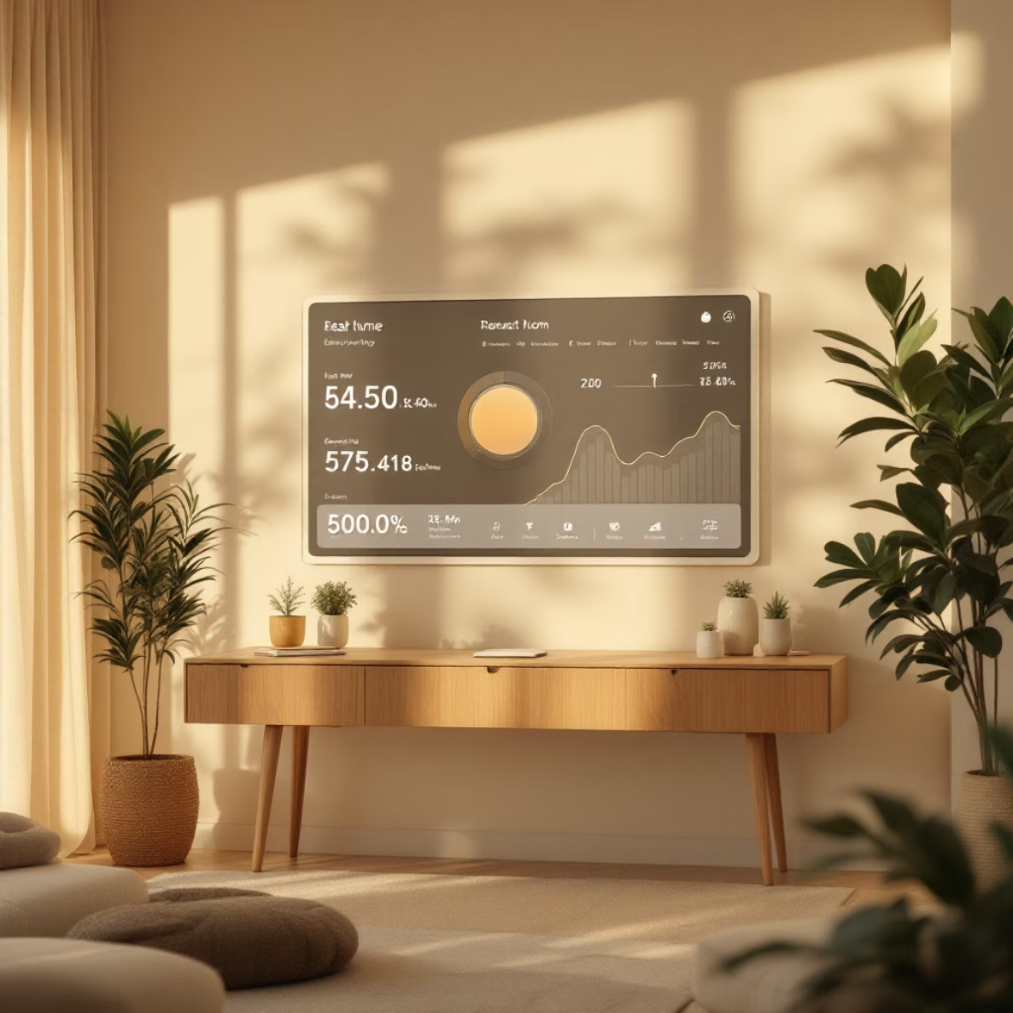
Core Explanation: Modules of a SHEMS
A Smart Home Energy Management System integrates several key components to function effectively.
SHEMS consists 6 modules
Authentication and Role Management
Smart device management
Real- time energy tracking
Analytics dashboard
Scheduling and Automation
Recommendation system

Slide 5




Core Explanation: Layered Architecture
The brain of the SHEMS orchestrates data and decision-making.
Controller Layer
Provides the interface for users to monitor energy usage and provides active control of smart devices
Service Layer
Processes the data retrieved by the repository layer.
Repository Layer
Acts as an abstraction layer between the database and services, ensuring secure, consistent, and structured data querying, insertion, and retrieval.
Database
This layer manages long-term storage and historical data for analysis.

Slide 6
Core Explanation: System Configuration - Technical Stack
Building a robust Smart Home Energy Management System requires a carefully selected technical stack, leveraging modern and efficient technologies.
Backend Foundation
Frontend Experience
Java 17: Latest LTS for performance and stability.
HTML5 + CSS3: Modern web structure and styling.
Spring Boot: Rapid application development and microservices.
Bootstrap: Responsive and mobile-first design framework.
Spring MVC: Robust framework for
web applications.
Hibernate/Spring Data JPA: Efficient database interaction.
REST APIs: Standardized communication for services.
Data Management
Development Workflow
MySQL or PostgreSQL: Reliable and scalable relational databases.
Maven: Project build automation and dependency management.
Git and GitHub: Version control and collaborative development.
Postman: API testing and documentation.

Slide 7

Real-Time Application: Industry Use Cases
SHEMS principles extend beyond residential, impacting various sectors.
Commercial Buildings
Healthcare Facilities
Automated lighting and HVAC in offices to reduce operational costs and carbon footprint.
Ensuring stable power supply for critical equipment and managing high energy demands efficiently.
Manufacturing Units
Data Centres
Monitoring machinery energy consumption to identify inefficiencies and schedule maintenance proactively.
Optimising cooling systems and power distribution to maintain server integrity and reduce energy overheads.

Slide 8
Advantages: Why SHEMS Matters
Smart Home Energy Management Systems offer a myriad of benefits for homeowners and the environment.
Cost Savings
Enhanced Comfort
Environmental Impact
Significant reduction in electricity bills through optimised usage and reduced waste.
Automated adjustments ensure optimal living conditions without manual intervention.
Lower carbon footprint by promoting energy efficiency and renewable energy use.
Increased Awareness
Grid Stability
Provides detailed insights into energy consumption, fostering smarter habits.
Contributes to a more stable and reliable electricity grid through demand-side management.

Slide 9
Limitations & Challenges
Despite their benefits, SHEMS face certain hurdles in widespread adoption.
Initial Investment
Data Privacy Concerns
Complexity of Setup
High upfront costs for installation of smart devices and integration systems.
Collection of detailed energy usage data raises questions about privacy and security.
Requires technical expertise for proper installation and configuration, which can deter users.
Interoperability Issues
Cybersecurity Risks
Lack of universal standards can lead to compatibility problems between different manufacturers' devices.
Vulnerability to cyberattacks, potentially compromising home security and data integrity.

Slide 10



Conclusion
Empowering Smart Living
Driving Efficiency
By integrating advanced technology, these systems enable optimal energy usage and significant savings.
Smart Home Energy Management Systems are pivotal in fostering a sustainable and efficient future.
A Greener Tomorrow
They are indispensable tools for reducing our environmental footprint and promoting eco-conscious living.

Slide 11

Thank You!
Any Questions?

